Slide 1
AVL Tree

Slide 2
AVL Tree
AVL Tree is invented by GM Adelson - Velsky and EM Landis in 1962. The tree is named AVL in honour of its inventors.
AVL Tree can be defined as height balanced binary search tree in which each node is associated with a balance factor which is calculated by subtracting the height of its right sub-tree from that of its left sub-tree.
Tree is said to be balanced if balance factor of each node is in between -1 to 1, otherwise, the tree will be unbalanced and need to be balanced.
Balance Factor (k) = height (left(k)) - height (right(k))
If balance factor of any node is 1, it means that the left sub-tree is one level higher than the right sub-tree.
If balance factor of any node is 0, it means that the left sub-tree and right sub-tree contain equal height.
If balance factor of any node is -1, it means that the left sub-tree is one level lower than the right sub-tree.

Slide 3
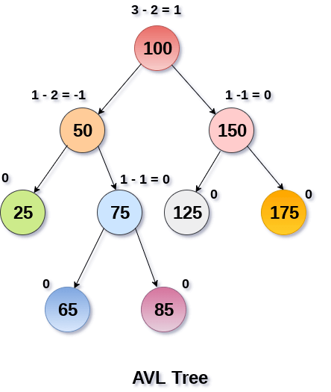
AVL tree

Slide 4
Why AVL Tree?
AVL tree controls the height of the binary search tree by not letting it to be skewed.
The time taken for all operations in a binary search tree of height h is O(h).
However, it can be extended to O(n) if the BST becomes skewed (i.e. worst case). By limiting this height to log n, AVL tree imposes an upper bound on each operation to be O(log n) where n is the number of nodes.

Slide 5
Insertion
Insertion in AVL tree is performed in the same way as it is performed in a binary search tree. However, it may lead to violation in the AVL tree property and therefore the tree may need balancing. The tree can be balanced by applying rotations.

Slide 6
Deletion
Deletion can also be performed in the same way as it is performed in a binary search tree. Deletion may also disturb the balance of the tree therefore, various types of rotations are used to rebalance the tree.

Slide 7
AVL Rotations
We perform rotation in AVL tree only in case if Balance Factor is other than -1, 0, and 1. There are basically four types of rotations which are as follows:
L L rotation: Inserted node is in the left subtree of left subtree of A
R R rotation : Inserted node is in the right subtree of right subtree of A
L R rotation : Inserted node is in the right subtree of left subtree of A
R L rotation : Inserted node is in the left subtree of right subtree of A
Where node A is the node whose balance Factor is other than -1, 0, 1.
The first two rotations LL and RR are single rotations and the next two rotations LR and RL are double rotations. For a tree to be unbalanced, minimum height must be at least 2

Slide 8
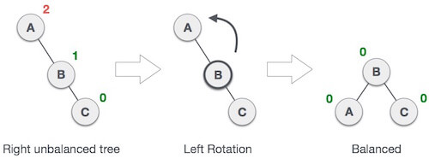
1. RR Rotation
When BST becomes unbalanced, due to a node is inserted into the right subtree of the right subtree of A, then we perform RR rotation
RR rotation is an anticlockwise rotation, which is applied on the edge below a node having balance factor -2
Node A has balance factor -2 because a node C is
inserted in the right subtree of A right subtree.
We perform the RR rotation on the edge below A

Slide 9
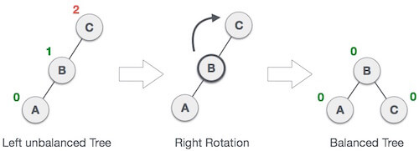
2. LL Rotation
When BST becomes unbalanced, due to a node is inserted into the left subtree of the left subtree of C, then we perform LL rotation, LL rotation is clockwise rotation, which is applied on the edge below a node having balance factor
Node C has balance factor 2 because a node A is
inserted in the left subtree of C left subtree. We
perform the LL rotation on the edge below A.

Slide 10
3. LR Rotation
Double rotations are bit tougher than single rotation which has already explained above. LR rotation = RR rotation + LL rotation, i.e., first RR rotation is performed on subtree and then LL rotation is performed on full tree, by full tree we mean the first node from the path of inserted node whose balance factor is other than -1, 0, or 1.

Slide 11
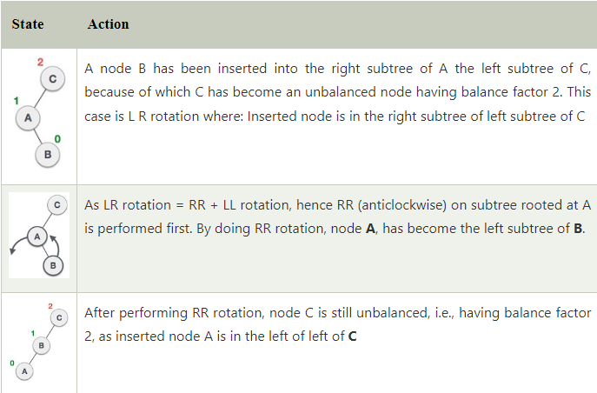
3. LR Rotation

Slide 12
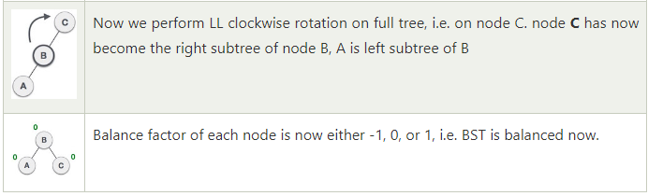
3. LR Rotation

Slide 13
3. RL Rotation
R L rotation = LL rotation + RR rotation, i.e., first LL rotation is performed on subtree and then RR rotation is performed on full tree, by full tree we mean the first node from the path of inserted node whose balance factor is other than -1, 0, or 1.

Slide 14
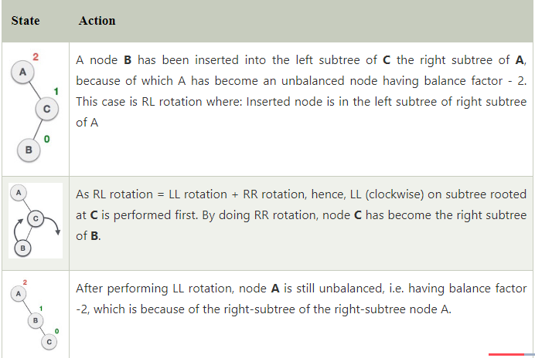
4. RL Rotation

Slide 15
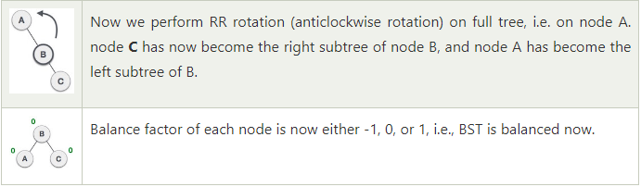
4. RL Rotation

Slide 16
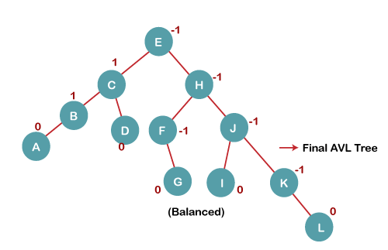
Construct an AVL tree having the following elements H, I, J, B, A, E, C, F, D, G, K, L

Slide 17
Applications of AVL Tree
It is used to index huge records in a database and also to efficiently search in that.
For all types of in-memory collections, including sets and dictionaries, AVL Trees are used.
Database applications, where insertions and deletions are less common but frequent data lookups are necessary
Software that needs optimized search.
It is applied in corporate areas and storyline games.

Slide 18
Advantages of AVL Tree
AVL trees can self-balance themselves.
It is surely not skewed.
It provides faster lookups than Red-Black Trees
Better searching time complexity compared to other trees like binary tree.
Height cannot exceed log(N), where, N is the total number of nodes in the tree.

Slide 19
Disadvantages of AVL Tree
It is difficult to implement.
It has high constant factors for some of the operations.
Less used compared to Red-Black trees.
Due to its rather strict balance, AVL trees provide complicated insertion and removal operations as more rotations are performed.
Take more processing for balancing.

